Slide 1
The Boiler Room
What do we know about the purpose of the boiler room? What is the transfer of energy?

Slide 2
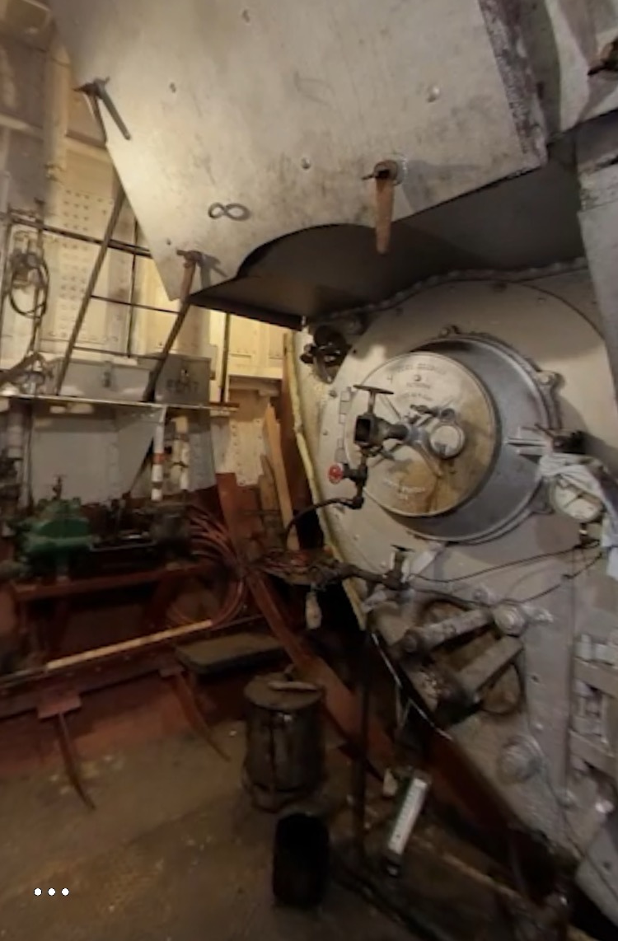
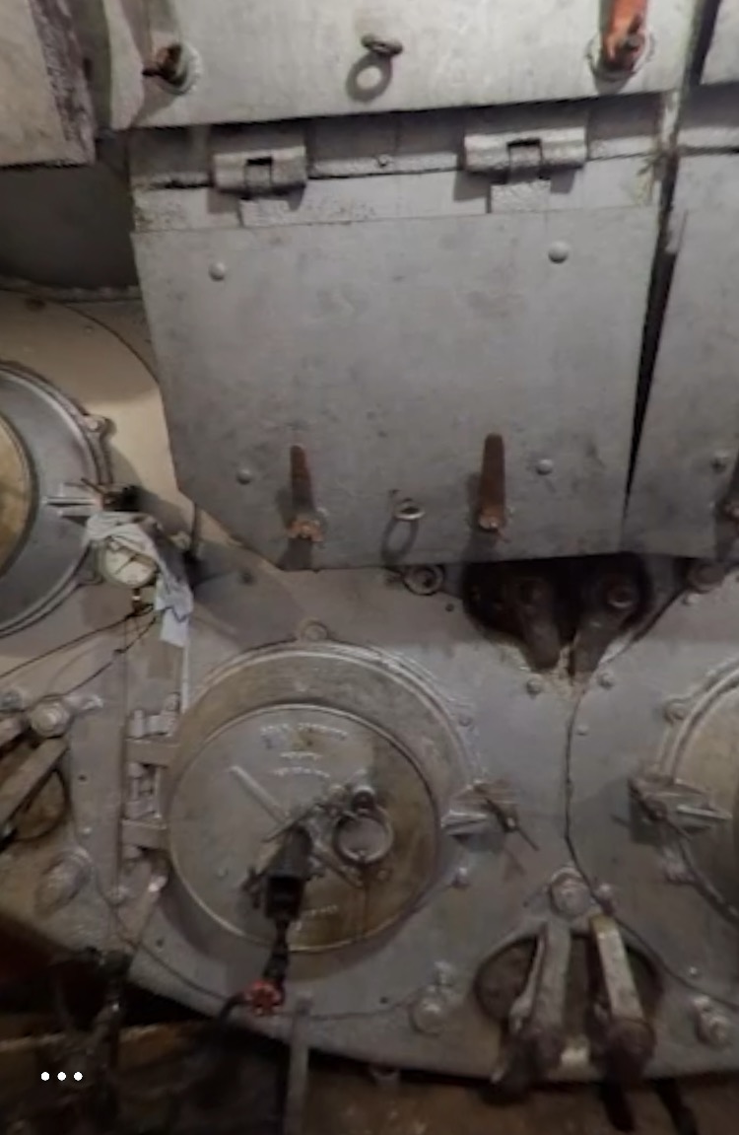
The Boiler Room #2
In the boiler room, fire heats up water. How is the fire created?
? + ? =🔥

Slide 3
Cause & Effect
Cause: The reason WHY something happened.
It rained outside.
Fire heats up the water.
Your example!
Your example!
Your example!
Effect: What happened.
I wore my raincoat.
Water converts to steam.
Your example!
Your example!
Your example!
Notes:
Examples could be: I was hungry, so I ate, It was hot out, so I wore shorts, etc.

Slide 4
Graphic Organizer
Topic:
Cause: The reason WHY something happened.
Effect: What happened.
Notes:
Topic: Weather Cause: It rained outside; Effect: I wore my raincoat; The purpose of this slide is to get students used to the format of their graphic organizer.

Slide 5
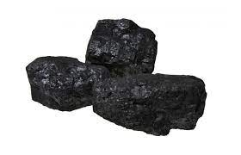
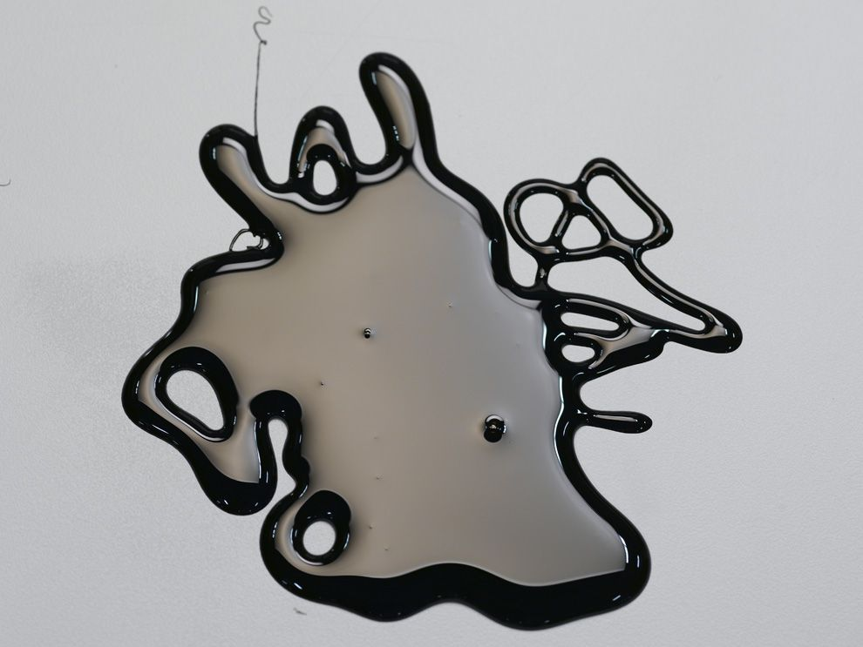
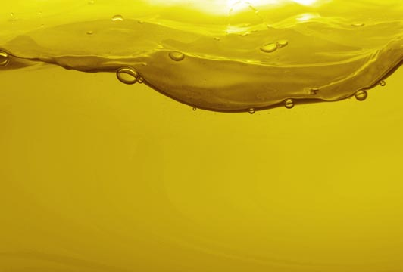
Fuel
Today, you will be learning about different types of fuel.
What is fuel? What examples of fuel do you see in your everyday life?
There are three types of fuel that can power a steam boat:
Coal: Also used to heat up barbecue pits.
Oil: Also used to power cars.
Diesel: Also used to power school buses.
Notes:
Fuel is something that gives energy. Examples of fuel could be oil in a car or food in our bodies.

Slide 6
Feature Article
A feature article is a non-fiction text that tells you about a topic in detail.
Today, you will read a feature article on fuel to answer the question: What fuel did Hercules use and why?
As you read, find the causes for why Hercules used coal/oil/diesel OR causes of reactions. Fill out the graphic organizer.

Slide 7
Class Share
What did you learn?
What causes and effects did you find?
What questions do you still have?
Notes:
Examples of causes & effects could be: if you combine fuel, air, and heat, then a fire will start & since California was oil rich, Hercules was created to take oil as fuel

Slide 8
Energy
Energy is all around us! Energy can be stored in things. It can also be used to make things change and move.
We has energy stored in our food. We use that energy when we run and play!
Here are some types of energy:
Chemical energy: energy that is stored in chemicals and is involved in reactions.
Heat (thermal) energy: energy in the form of heat.
Mechanical (motion) energy: energy in the form of movement.
When do you see these forms of energy in your everyday life? Can you think of other types of energy you see?
Notes:
Examples of chemical energy in our everyday lives: using oil in a car, eating food to do work
Examples of heat energy in our everyday lives: turning on the heater, using a toaster oven
Examples of mechanical energy in our everyday lives: a car moving, our bodies moving

Slide 9
Energy Transfer
Energy comes in all forms! Some examples are heat energy, electrical energy, sound energy, and light energy.
Energy can be transferred, or converted, from one form to another.
When we eat food and then move around, we transfer chemical (stored) stored in food to mechanical (movement) energy.
When we use a toaster oven, we transfer electrical energy from the wires in the wall to heat energy to toast our bread.
Can you think of another time in your everyday life where you see an energy transfer?
Notes:
Other energy transfers: plugging in a fan to convert electrical energy into movement (mechanical) energy, turning on the radio to convert electrical energy into sound energy

Slide 10
Experiment
Observe closely as your teacher uses fuel, air, and heat to create fire. What do you observe? Write about and draw your observations!
How do you think this experiment connects back to what is happening in the boiler room? What kind of energy transfer do you observe?
Observational Drawing
Accurate Big Colorful Detailed Explained (includes labels)
Notes:
Experiment: Show students how the burner uses fuel (from the can), air (from the surroundings), and heat (from the spark) to create fire. In the boiler room, fuel (from oil), air (from the surroundings), and heat (from a small fire) work together to create a large fire. Chemical energy from the fuel is transferred to heat energy. Connect back to the boiler room.

Slide 11
Exit Ticket
What is the transfer of energy in the boiler room? Use the word bank to help you label the different types of energies as they pass through the systems.
Try your best! We will review this information tomorrow.
Word Bank
Heat energy Mechanical (movement) energy Chemical Energy
Notes:
View Exit Ticket for answers!

